Slide 1
Towards the Internet of Everything…
David E. Culler
CS162 – Operating Systems and Systems Programming
http://cs162.eecs.berkeley.edu/
Lecture 41
December 5, 2014
8

Slide 2
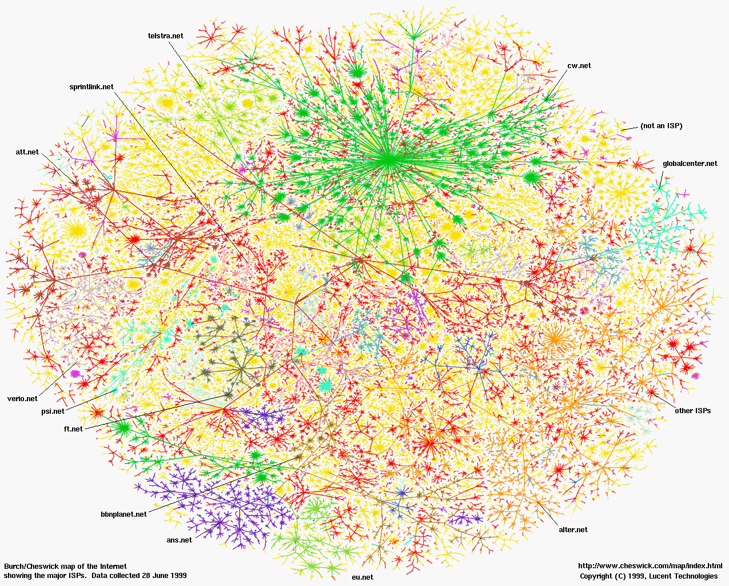

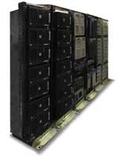
1997 - The Internet of Every Computer

Slide 3
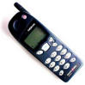
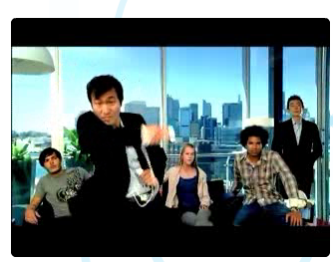
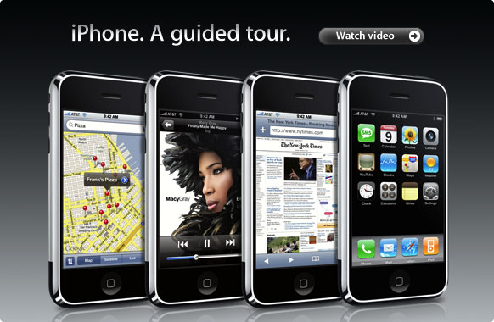
2007 - The Internet of Every Body

Slide 4
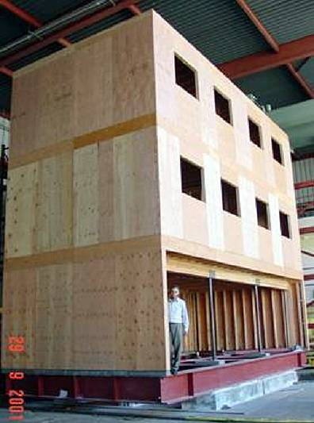
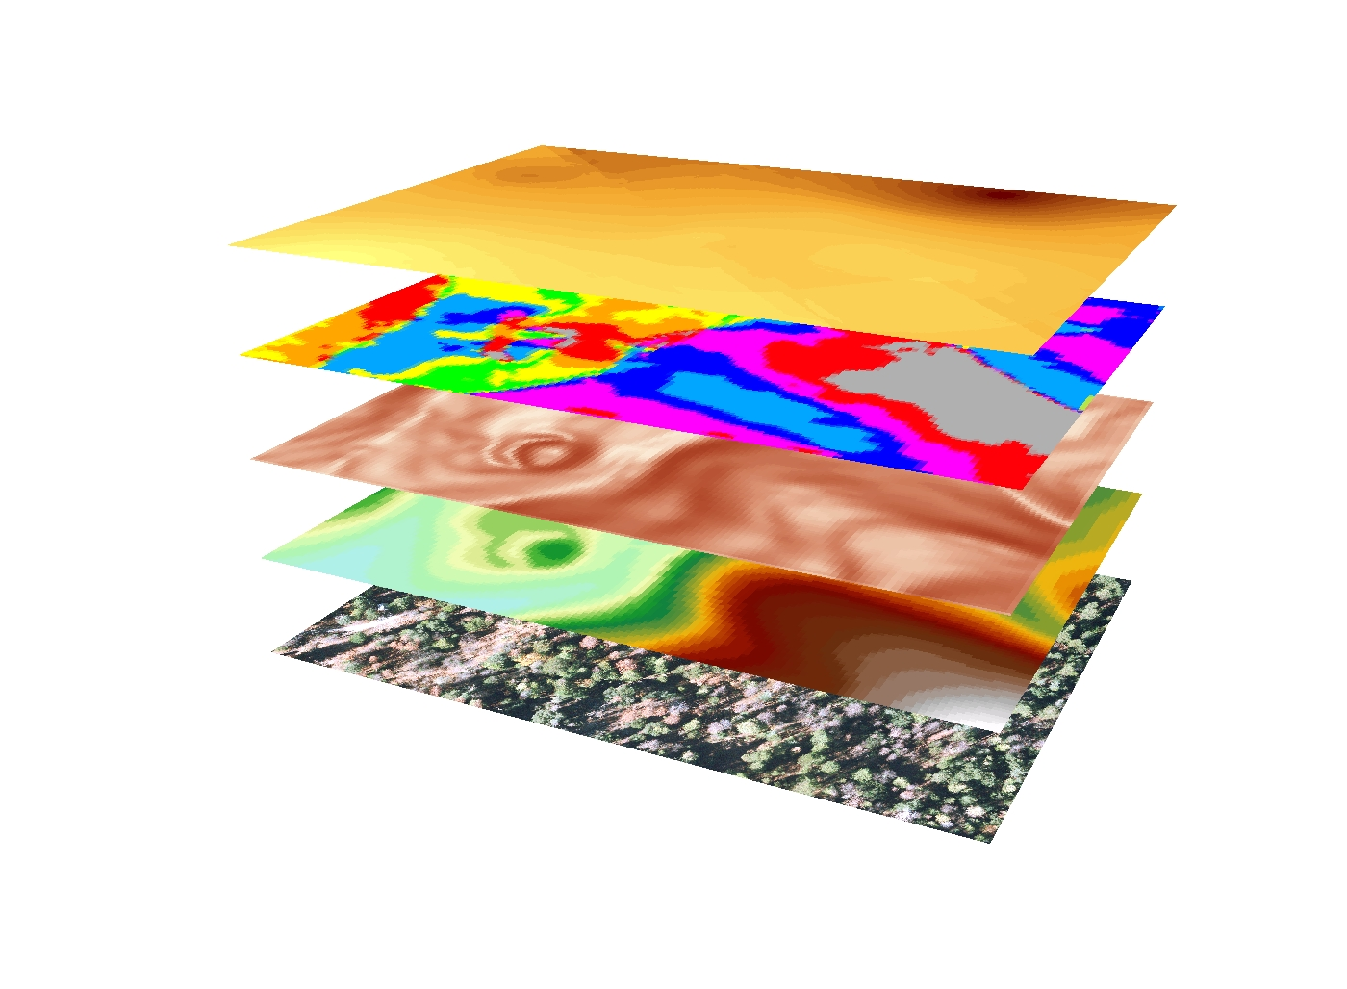
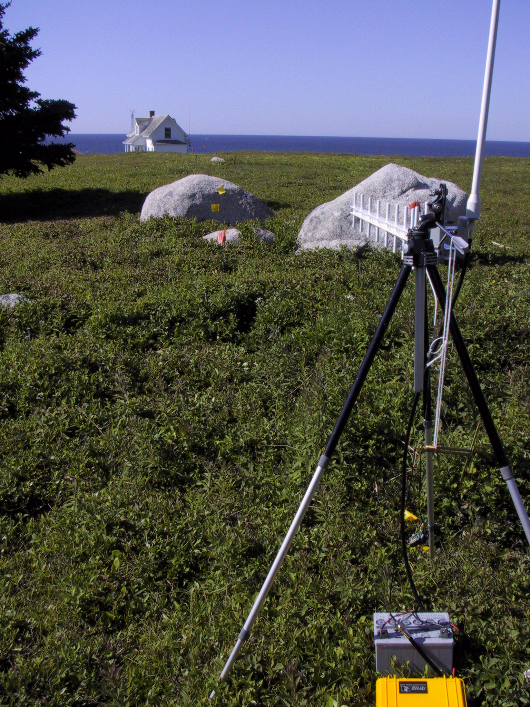
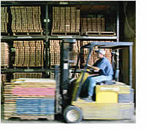
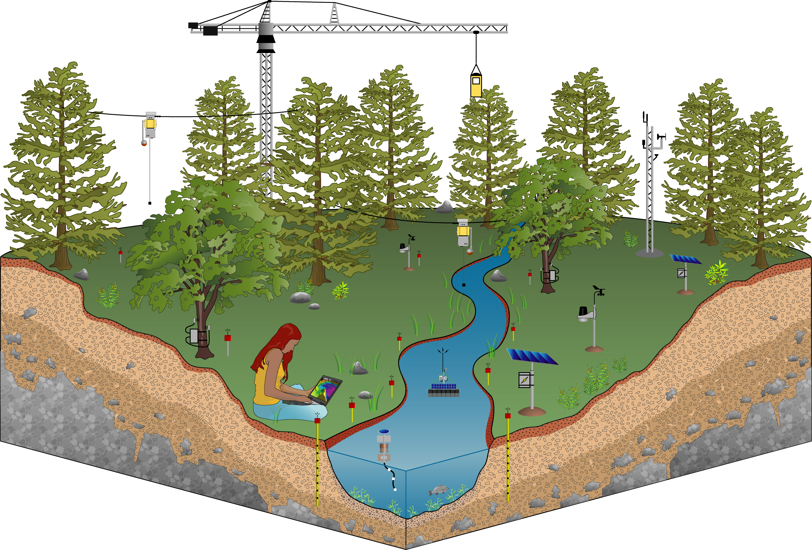


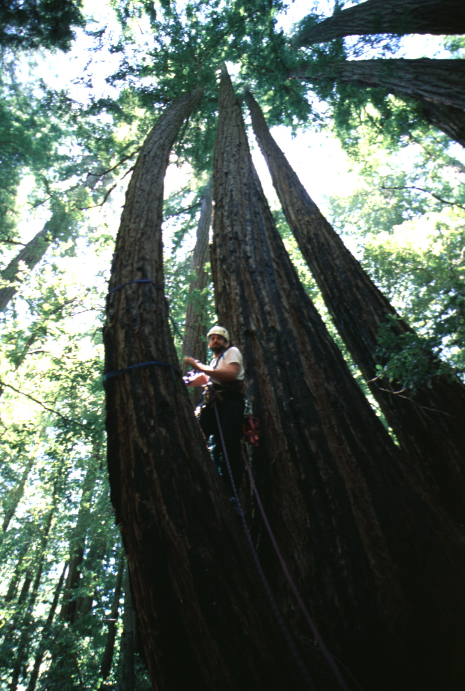

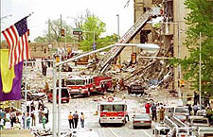

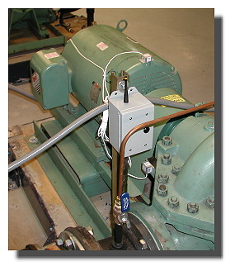
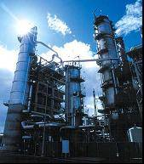
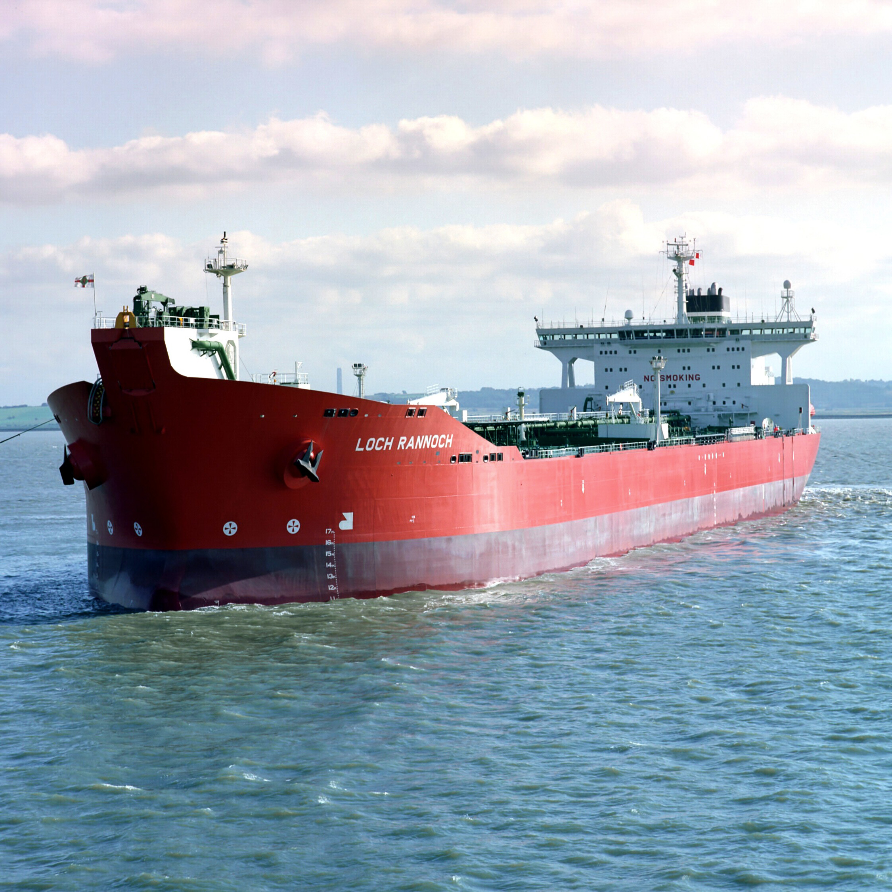

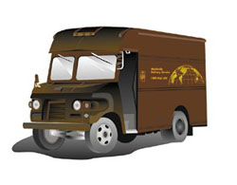
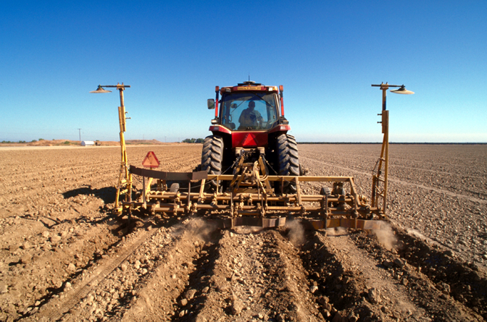


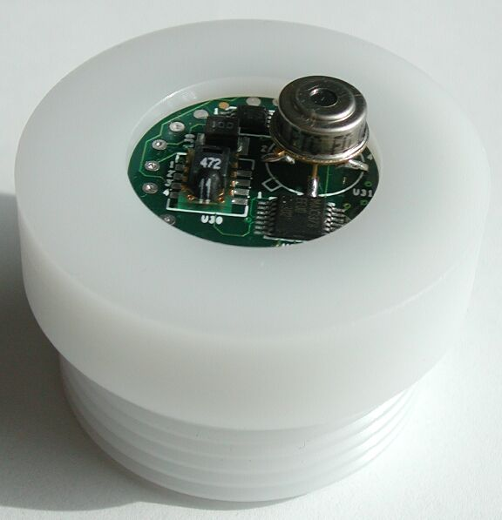
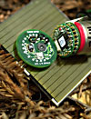
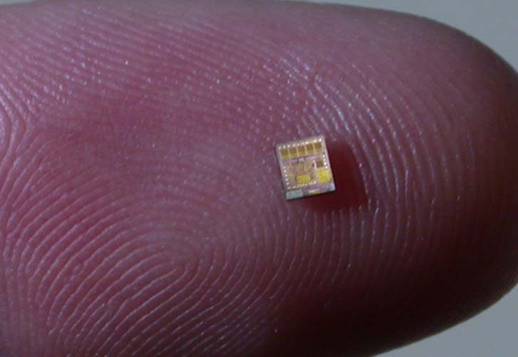
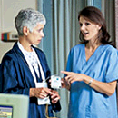
2017 - The Internet of Everyday Things

Slide 5
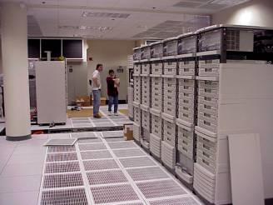
Why “Real” Information is so Important
Save Resources
Improve Productivity
Enable New Knowledge
Increase
Comfort
Enhance Safety & Security
Preventing Failures
High-Confidence Transport
Improve Food & H20
Protect Health

Slide 6
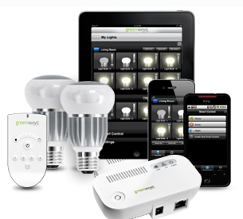
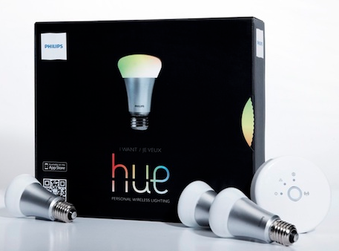
2013

Slide 7
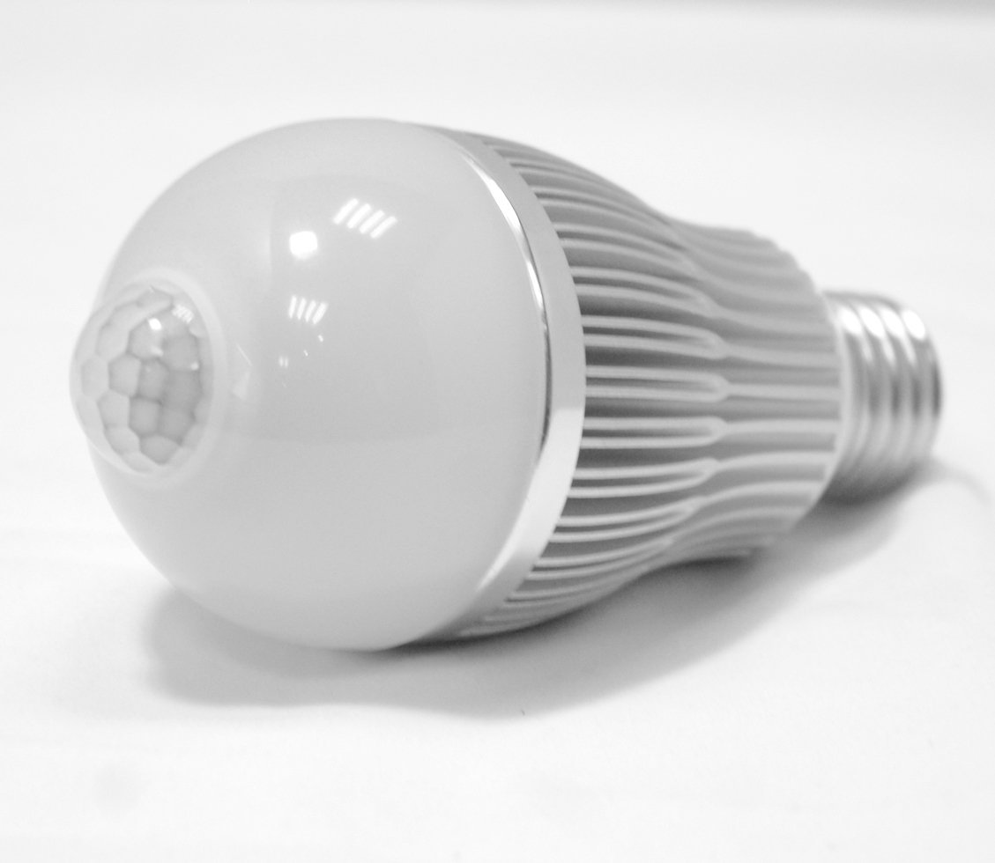
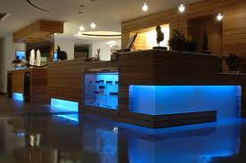
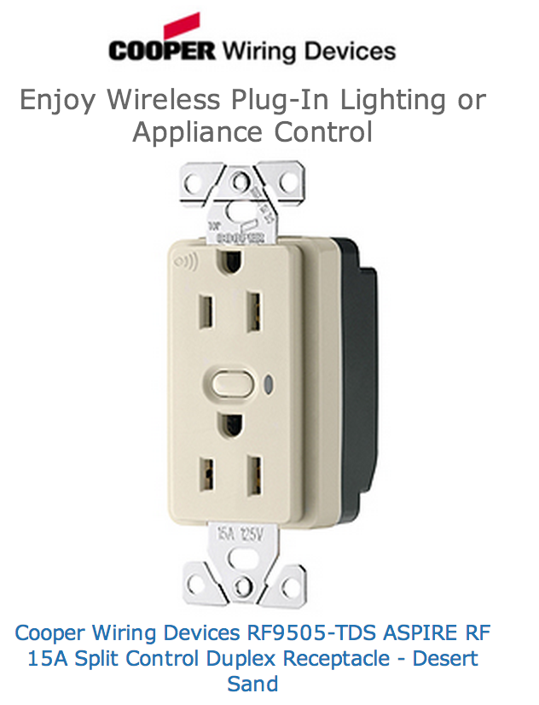
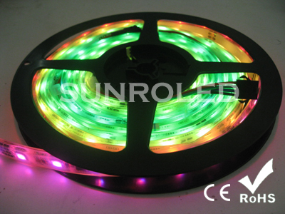
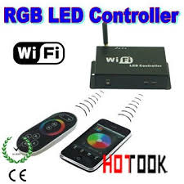
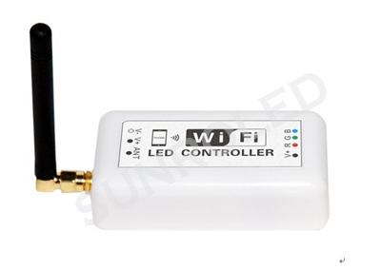
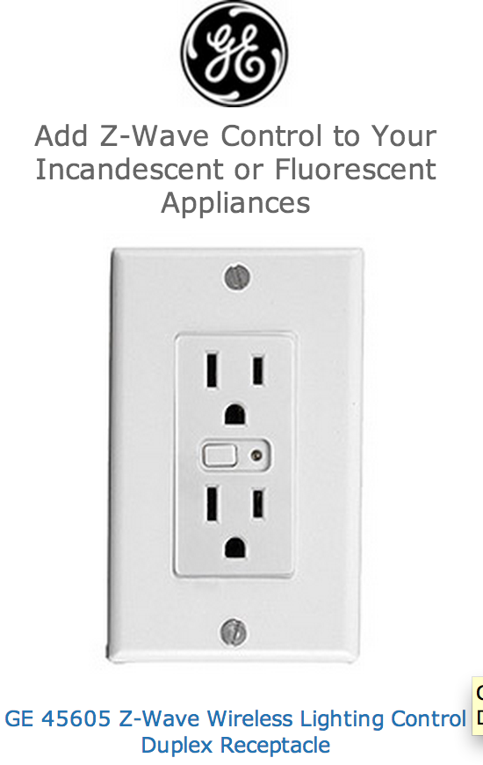
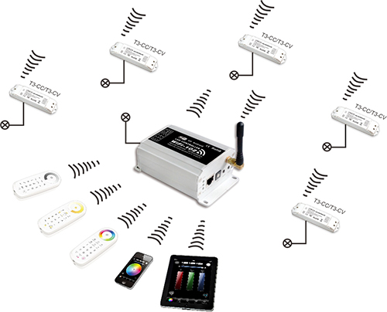
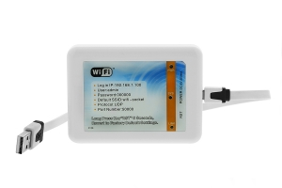
2014

Slide 8
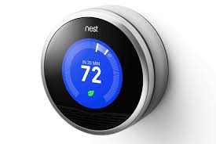
2013

Slide 9
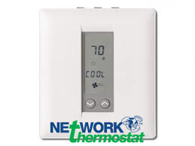
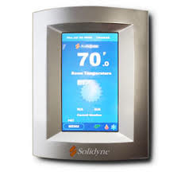
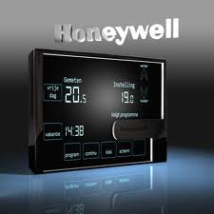
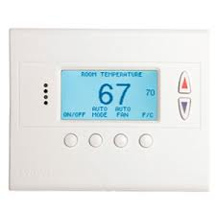
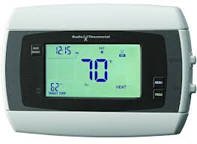
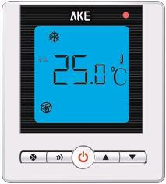
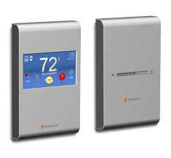
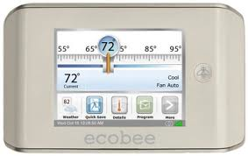
2014

Slide 10
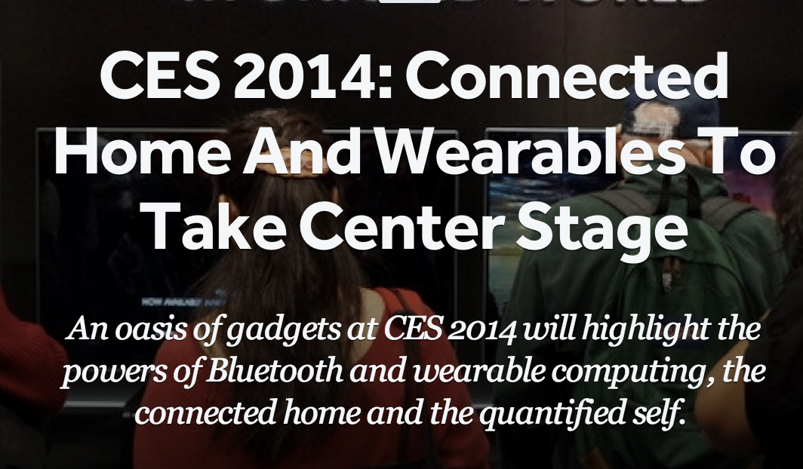

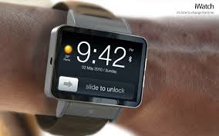
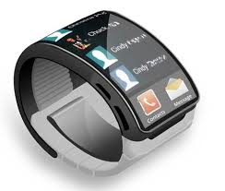
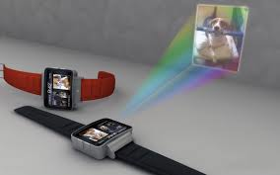
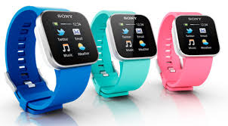
2014

Slide 11
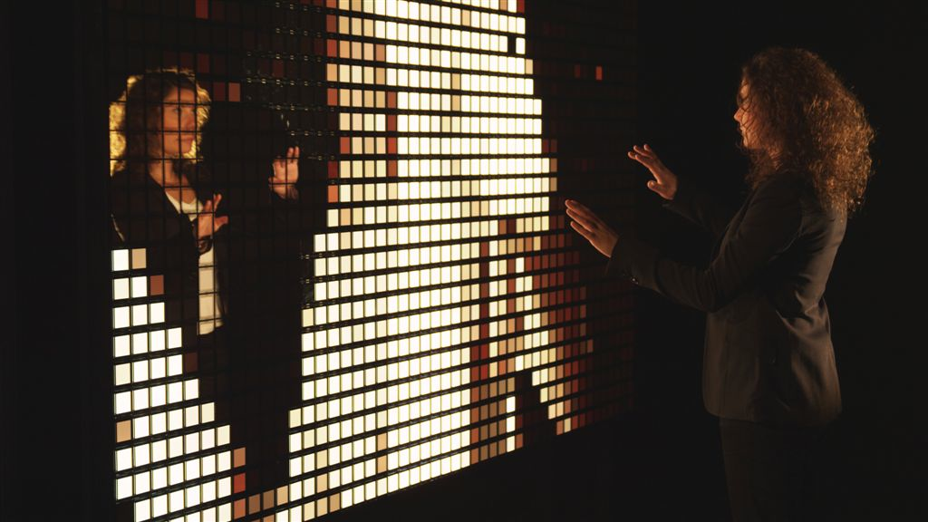

Slide 12
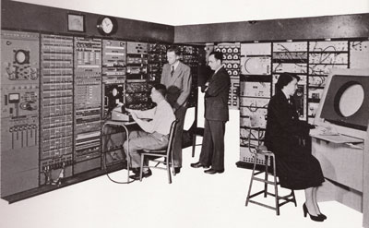
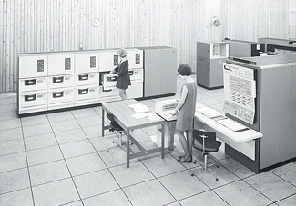







Broad Technology Trends
Moore’s Law: # transistors on cost-effective chip doubles every 18 months
Bell’s Law: a new computer class emerges every 10 years
Computers
Per Person
1:10⁶
Mainframe
Mini
1:10³
Workstation
PC
1:1
Laptop
PDA
Cell
Today: 1 million transistors per $
10³:1
years
Mote!
Same fabrication technology provides CMOS radios for communication and micro-sensors

Slide 13




















‘Low-Tech’ Enabling Technology
Network
Microcontroller
Flash
Storage
Radio
Communication
Sensors
IEEE 802.15.4

Slide 14



The Systems Challenge
Monitoring & Managing Spaces and Things
applications
data
mgmt
service
network
system
architecture
Comm.
Store
actuate
sensing
Proc
technology
Power
Miniature, low-power connections to the physical world
Notes:
Now that we’ve set the context, here’s a picture of the rest of the presentation
I do
Kris does

Slide 15
Leading Internet Research Perspective ~ 1999
“Resource constraints may cause us to give up the layered architecture.”
“Sheer numbers of devices, and their unattended deployment, will preclude reliance on broadcast communication or the configuration currently needed to deploy and operate networked devices.”
“There are significant robustness and scalability advantages to designing applications using localized algorithms.”
“Unlike traditional networks, a sensor node may not need an identity (e.g. address).”
“It is reasonable to assume that sensor networks can be tailored to the application at hand.”
We were wrong...

Slide 16
Key WSN Research Developments
Event-Driven Component-Base Operating System
Framework for building System & Network abstractions
Low-Power Protocols
Hardware and Application Specific
Idle listening
All the energy is consumed by listening for a packet to receive
=> Turn radio on only when there is something to hear
Reliable routing on Low-Power & Lossy Links
Power, Range, Obstructions => multi-hop
Always at edge of SNR => loss is common
=> monitoring, retransmission, and local rerouting
Trickle – don’t flood (tx rate < 1/density, and < info change)
Connectivity is determined by physical points of interest, not network designer.
never naively respond to a broadcast
re-broadcast very very politely

Slide 17
Decade of Networking (sans Architecture)
Application
Transport
Deluge
Drip
Dip
GAF
SPIN
GDI
Redwoods
North Sea
Volcano
Golden Gate Bridge
Network
Drain
Flush
Broadcast Storm
TinyOS 0.6
PSFQ
RMST
CODA
FPS
Fusion
MultihopLQI
BVR
CTP
S4
MintRoute
SP
Link
WooMAC
S-MAC
Aloha PS
T-MAC
B-MAC
WiseMAC
SCP-MAC
PEDAMACS
X-MAC
1999
2000
2001
2002
2003
2004
2005
2006
2007
2008

Slide 18


Internet of Every Thing – Realized 2008
 | ROM | RAM
CC2420 Driver | 3149 | 272
802.15.4 Encryption | 1194 | 101
Media Access Control | 330 | 9
Media Management Control | 1348 | 20
6LoWPAN + IPv6 | 2550 | 0
Checksums | 134 | 0
SLAAC | 216 | 32
DHCPv6 Client | 212 | 3
DHCPv6 Proxy | 104 | 2
ICMPv6 | 522 | 0
Unicast Forwarder | 1158 | 451
Multicast Forwarder | 352 | 4
Message Buffers | 0 | 2048
Router | 2050 | 106
UDP | 450 | 6
TCP | 1674 | 50
24038 | ROM
3598 | RAM
(including runtime)
* Production implementation on TI msp430/cc2420
Footprint, power, packet size, & bandwidth
Open version 27k / 4.6k

Slide 19






Internet of Every Thing – standardized 2010

Slide 20



Smart meter rollouts
Open IPv6, …
Proprietary / Zigbee
http://www.edisonfoundation.net/iee/Documents/IEE_SmartMeterRollouts_0512.pdf

Slide 21
Hardware

Slide 22





































The Mote/TinyOS revolution…
Mote inside
uP => Arm Cortex
Radio => 802.15.4g narrow=band freq. hopper
TinyOS too
SOC from here
zeevo BT
Intel
iMOTE
Intel
MOTE2
Intel
rene’
Intel/UCB
dot
BTNode
Intel
cf-mica
Eyes
trio
IETF RPL
SmartDust
WeC
LoWPAN/IPv6
Rene
Mica
Telos
Epic
XBOW
rene2
XBOW
mica
XBOW
cc-dot
XBOW
mica2
XBOW
micaZ
digital sun
rain-mica
Bosch
cc-mica
Dust Inc
blue cc-TI
98
99
00
01
02
03
04
05
06
07
10
11
SENSIT
Expedition
8 kB rom
½ kB ram
NEST
NSF
CENS STC
48 kB rom
10 kB ram
802.15.4
NETS/ NOSS
Cyber-Physical

Slide 23

Example 2004 Mote: TelosB
jtag
user button
reset button
TSR photodiode
PAR photodiode
LEDs
SHT11 humidity / temp
6 pin expansion
USB-serial
10 pin expansion
reset support
(bottom)
TI MSP430 F1611
ST M25P80 flash
serial ID
PIFA Antenna
CC2420
IEEE 802.15.4 radio

Slide 24

Microcontrollers
48K ROM
10K RAM
250 kbps

Slide 25
Mote Characteristics
Limited resources
RAM, ROM, Computation, Energy
➔ Wakeup, do work as quickly as possible, sleep
Hardware modules operate concurrently
No parallel execution of code (not Core 2 Duos!)
➔ Asynchronous operation is first class
Diverse application requirements
➔ Efficient modularity
Robust operation
Numerous, unattended, critical
➔ Predictable operation

Slide 26
What we mean by “Low Power”
2 AA => 1.5 amp hours (~4 watt hours)
Cell => 1 amp hour (3.5 watt hours)
Cell: 500 -1000 mW => few hours active
WiFi: 300 - 500 mW => several hours
GPS: 50 – 100 mW => couple days
WSN: 50 mW active, 20 uW passive
450 uW => one year
45 uW => ~10 years
Ave Power = f_{act} * P_{act} + f_{sleep} * P_{sleep} + f_{waking} * P_{waking}
* System design
* Leakage (~RAM)
* Nobody fools mother nature

Slide 27

Storm 2014

Slide 28



TinyOS – Framework for Innovation
Applications and Services
Over-the-air
Programming
Network
Protocols
Blocks, Logs, Files
Scheduling, Management
Streaming drivers
Link
Radio Serial
Flash
MCU, Timers, Bus,…
ADC, Sensor I/F
WSN mote platform
Wireless
Storage
Processing
Sensors
Communication Centric
Resource-Constrained
Event-driven Execution

Slide 29






















UCB => A worldwide community
Wireless Sensor Networks
SmartDust
NEST
Storage
Sensors
Wireless
Processing

Slide 30
Low Power Networking in the Real World
Applications
Network
system
architecture
Technology
Wireless
Storage
Processing
Sensors
Notes:
Now that we’ve set the context, here’s a picture of the rest of the presentation
I do
Kris does

Slide 31


A Low-Power Standard Link
 | 802.15.4 | 802.15.1 | 802.15.3 | 802.11 | 802.3
Class | WPAN | WPAN | WPAN | WLAN | LAN
Lifetime (days) | 100-1000+ | 1-7 | Powered | 0.1-5 | Powered
Net Size | 65535 | 7 | 243 | 30 | 1024
BW (kbps) | 20-250 | 720 | 11,000+ | 11,000+ | 100,000+
Range (m) | 1-75+ | 1-10+ | 10 | 1-100 | 185 (wired)
Goals | Low Power, Large Scale, Low Cost | Cable Replacement | Cable Replacement | Throughput | Throughput
Low Transmit power, Low Signal-to-noise Ratio (SNR), modest BW, Little Frames
BTLE

Slide 32
The “Idle Listening” Problem
The power consumption of “short range” (i.e., low-power) wireless communications is roughly the same when
transmitting,
receiving,
or simply ON, “listening” for potential reception.
IEEE 802.15.4, Zwave, Bluetooth, …, WiFi
Radio must be ON (listening) in order receive anything.
Transmission is rare
Listening happens all the time
Energy consumption dominated by idle listening
Do Nothing Well

Slide 33
Communication Power – Passive Vigilance
Sleep
~10 uA
Transmit
~20 mA x 1-5 ms
[20 - 100 uAs]
I
Time
I
Time
Listen
~20 mA x * ???
Receive
~20 mA x 2-6 ms
Listen just when there is something to hear …

Slide 34

3 Basic Solution Techniques
Scheduled Listening
Arrange a schedule of communication Time Slots
Maintain coordinated clocks and schedule
Listen during specific “slots”
Many variants:
Aloha, Token-Ring, TDMA, Beacons, Bluetooth piconets, …
S-MAC, T-MAC, PEDAMACS, TSMP, FPS, …
Sampled Listening
Listen for very short intervals to detect eminent transmissions
On detection, listen actively to receive
DARPA packet radio, LPL, BMAC, XMAC, …
Maintain “always on” illusion, Robust
Listen after send (with powered infrastructure)
After transmit to a receptive device, listen for a short time
Many variants: 802.11 AMAT, Key fobs, remote modems, …
Many hybrids possible
802.15.4e

Slide 35
Self-Organized Routing - nutshell
Receiver diversity through dynamic rerouting
2
2
2
2
Retrans. rate < 1/density
Neighbor table exceeds RAM
Dissem. rate < change
1
2
1
0

Slide 36

Key IPv6 Contributions
Large simple address
Network ID + Interface ID
Plenty of addresses, easy to allocate and manage
Autoconfiguration and Management
ICMPv6
Integrated bootstrap and discovery
Neighbors, routers, DHCP
Protocol options framework
Plan for extensibility
Simplify for speed
MTU discovery with min
6-to-4 translation for compatibility
128 bits
Prefix
IID
ICMPv6
IPv6 Base
HbH Opt
Routing
Fragment
Dst Opt

Slide 37
6LoWPAN – IPv6 over 802.15.4
UDP datagram or
TCP stream segment
…, modbus, BacNET/IP, … , HTML, XML, …, ZCL
transport header
application payload
Network packet
40 B + options
cls
flow
len
hops
NH
src IP
dst IP
net payload
16 B
16 B
Link frame
1280 Bytes MIN
?
ctrl
len
src UID
dst UID
link payload
chk
128 Bytes MAX
Large IP Address & Header => 16 bit short address / 64 bit EUID
Minimum Transfer Unit => Fragmentation
Short range & Embedded => Multiple Hops

Slide 38
6LoWPAN adaptation layer
Diverse Object and Data Models (HTML, XML, …, BacNet, …)
7: app
Application (Telnet, FTP, SMTP, SNMP, HTTP)
4: xport
Transport (UDP/IP, TCP/IP)
3: net
Network (IP)
6LoWPAN
2: link
Link
Serial
Modem
X3T9.5
FDDI
802.3
Ethernet
802.5
Token Ring
802.11
WiFi
802.15.4
LoWPAN
802.3a
Ethernet
10b2
802.11a
WiFi
802.3i
Ethernet
10bT
802.11b
WiFi
ISDN
Sonet
802.3y
Ethernet
100bT
802.11g
WiFi
DSL
802.3ab
Ethernet
1000bT
802.11n
WiFi
GPRS
802.3an
Ethernet
1G bT
1: phy

Slide 39

6LoWPAN – IP Header Optimization
Network packet
40 B
cls
flow
len
hops
NH
src IP
dst IP
net payload
Link frame
3 B
ctrl
len
src UID
dst UID
hops
chk
6LoWPAN adaptation header
Eliminate all fields in the IPv6 header that can be derived from the 802.15.4 header in the common case
Source address : derived from link address
Destination address : derived from link address
Length : derived from link frame length
Traffic Class & Flow Label : zero
Next header : UDP, TCP, or ICMP
Additional IPv6 options follow as options

Slide 40
Internet – WSN assimilated
Diverse Object and Data Models (HTML, XML, …, BacNet, …)
7: app
Application (Telnet, FTP, SMTP, SNMP, HTTP)
COAP
4: xport
Transport (UDP/IP, TCP/IP)
3: net
Network (IP)
RPL RFC6550
6LoWPAN RFC6282
2: link
Link
Serial
Modem
X3T9.5
FDDI
802.3
Ethernet
802.5
Token Ring
802.11
WiFi
802.15.4
LoWPAN
802.3a
Ethernet
10b2
802.11a
WiFi
802.3i
Ethernet
10bT
802.11b
WiFi
ISDN
Sonet
802.3y
Ethernet
100bT
802.11g
WiFi
802.15.4e
802.15.4g
P1901.2
DSL
802.3ab
Ethernet
1000bT
802.11n
WiFi
GPRS
802.3an
Ethernet
1G bT
1: phy

Slide 41
Complete Embedded IPv6 Stack
App
HTTP
Telnet
SNMP
DNS
…
DHCPv6
Tran
UDP
TCP
Net
Forwarder
Router
ICMPv6
Autoconf
Multicast
Unicast
Routing Protocol
Buffer
Queue
Send Manager
Forwarding Table
Prefix | Next
Default
Routing Table
Send Manager
Prefix | Next
Stateless
Autoconf
6LoWPAN Adaptation
Link
Data
Ack
Media Management Control
Remote Media
Link Stats
Local Media
Neighbor Table
Addr | Period | Phase | Pending | RSSI | PRR
Sample Period
Sample Phase

Slide 42
Adding up the pieces
 | ROM | RAM
CC2420 Driver | 3149 | 272
802.15.4 Encryption | 1194 | 101
Media Access Control | 330 | 9
Media Management Control | 1348 | 20
6LoWPAN + IPv6 | 2550 | 0
Checksums | 134 | 0
SLAAC | 216 | 32
DHCPv6 Client | 212 | 3
DHCPv6 Proxy | 104 | 2
ICMPv6 | 522 | 0
Unicast Forwarder | 1158 | 451
Multicast Forwarder | 352 | 4
Message Buffers | 0 | 2048
Router | 2050 | 106
UDP | 450 | 6
TCP | 1674 | 50
24038 | ROM
3598 | RAM
(including runtime)
* Production implementation on TI msp430/cc2420

Slide 43






Real World – “Signals” and “Information”
What is the bandwidth of the weather?
What is the nyquist of the soil?
What is the placement noise?
What is the sampling jitter error?
How do you classify it?
How do you search it?

Slide 44




The Macroscope - Keck HydroWatch
Sagehen wireless
data infrastructure
Colored digital vegetation and topography from a lidar survey

Slide 45


Networking the Physical World
Bi-directional
Patch Antenna
Mote + Accelerometer Board)
Battery

Slide 46

Ambient Vibration
SF
(south)
500 ft
1125 ft
4200 ft
246 ft
Sausalito
(north)
8 nodes
51 nodes
Vertical Sensor at Quarter-span 365m North of the South Tower
Vertical Sensor at Quarter-span 335m South of the North Tower

Slide 47





Bonus – Spectacular Views

Slide 48







Real World …

Slide 49

The “Killer App” for WSNs
Energy and the environmental impact of extraction, use, and disposal
THE problem of the Industrial Age
We need to find Information Age solutions to THE Industrial Age Problem
=> Fundamental transformation in the architecture of the electric grid

Slide 50

















Traditional Load-Following Grid
Baseline + Dispatchable Tiers
Oblivious Loads
Generation
Transmission
Distribution
Demand

Slide 51










Towards an ‘Aware’ Energy Infrastructure
Baseline + Dispatchable Tiers
Oblivious Loads
Generation
Transmission
Distribution
Demand
Non-Dispatchable
Sources
Aware Interactive Loads
Communication
Communication

Slide 52
How can we transform buildings into fundamentally more agile machines?
Programmable
Separation of the hardware capabilities (primitives)
from the universe of potential behaviors (applications)
allow them to be tailored to our desires
To the full extent of the underlying capabilities
And become good citizens of the grid

Slide 53
Software Defined Buildings
Building Application Programming Interface (BAS)
Enable application portability and innovation
Building Operation System & Services (BOSS)
Physical services and distributed device drivers
Middle services: mapping, transactions, RAS
Application services: baselining, ensemble, …
Innovate in Model-Driven Predictive Control
objectives: efficiency, satisfaction, supply-following
Rich Human-Building Interaction
Location, personal and ambient devices, gestures, …
Introduce meaningful security

Slide 54
BOSS Architecture – first cut
prognostics/ diagnostics
Bldg
Entity/Rel
Graph
External Interactions
Occupant displays & interaction
Model Training
Advanced Control Apps
CPS Application Environment
Application Programming Interface & Runtime
Stream Query
Submit/Callback
Request/Auth Token
System Services
Authorization Service
Context & Historian
Transaction Manager
Reliability
Fault-Tolerance
Security
Data Archiving
Hardware Independence
Authorization Manager
TimeSeries
metadata
Driver
Driver
Driver
Driver
Driver
publish
Deployment key, config & base metadata
command
sMAP
driver inst
sMAP
driver inst
sMAP
driver inst
sMAP
driver inst
Hardware Presentation Layer
6LoWPAN
XML/HTTP
BACnet/IP
…
OPC-DA
ModBus
RS-485
Physical Systems
CO₂/Motion/…
Data feeds,
Calendar, …
Bldg Mgmt System

Slide 55

The Revolution
Computers
People
Everything
1T
100B
Awareness
10B
Community
1B
Connectivity
10M
1990
2000
2010
2020

Slide 56

The Revolution
Computers
People
Everything
1T
$100
100B
Cost to Connect
$1
10B
1¢
1B
Things Connected
10M
1990
2000
2010
2020

Slide 57
CS162: Spiral
File Systems (8)
Address Space (4)
Concurrency (6)
Reliability, Security, Cloud (8)
Distributed Systems (8)
OS Concepts (3)
intro

